Slide 1
Java Server Pages
Presented by : Asfiya Khan ( Sr. Technical Trainer)

Slide 2
Agenda
Introduction to JSP Technology
Lifecycle of JSP
JSP Directives
JSP Implicit Objects
JSP Standard Actions

Slide 3
Introduction to JSP
Embedding java code into tags
Separation of Presentation from Business logic
Template based content generation

Slide 4
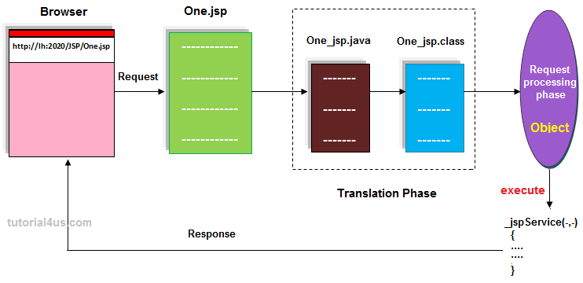
How JSP works?

Slide 5
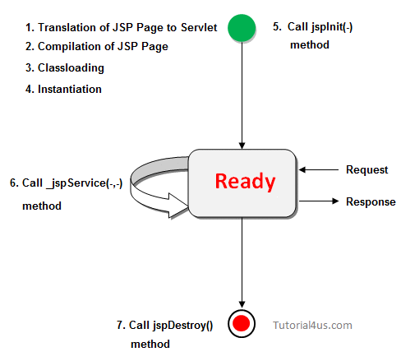
Life Cycle of JSP
Translation of JSP Page to Servlet
Compilation of JSP Page
Classloading (class file is loaded by the classloader)
Instantiation (Object of the Generated Servlet is created).
Initialization ( jspInit() method is invoked by the container).
Reqeust processing ( _jspService() method is invoked by the container).
Destroy ( jspDestroy() method is invoked by the container).

Slide 6
JSP Components
Three types of predefined tags:
Scripting elements
Implicit objects
Directives
Actions

Slide 7
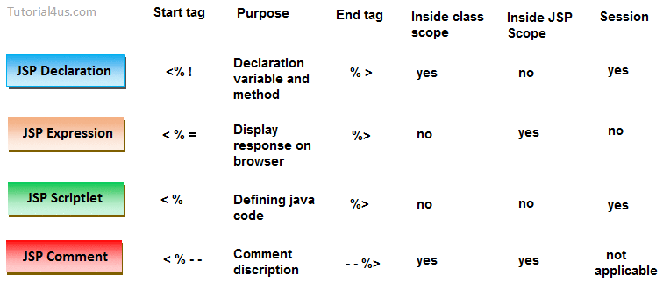
JSP Scripting Elements

Slide 8
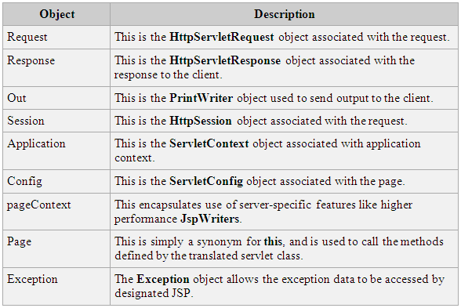
JSP Implicit Objects

Slide 9
JSP Directives
The directive elements are used to do page related operation during page translation time.
There are three types of directives:
Page directive
Include directive
Taglib directive

Slide 10
JSP Directives
The general syntax for JSP Directives
<%@ directive [---] %>
@page : Controls JSP Page properties
@include : Includes content of a file into JSP page at
translation time
@taglib : Makes a custom tag library available within
JSP

Slide 11
Page Directive Attributes
import
language
extends
session
buffer
isThreadSafe
info
errorPage
isErrorPage
contentType
autoflush

Slide 12
Include directive
Syntax:
<%@ include file= “file name” %>

Slide 13
Include directive
Syntax:
<%@ include file= “file name” %>

Slide 14
JSP Standard Actions
Action element | Description
<jsp:useBean> | Makes a JavaBeans component available in a page
<jsp:getProperty> | Gets a property value from a JavaBeans component and adds it to the response
<jsp:setProperty> | Sets a JavaBeans component property value

Slide 15
JSP Standard Actions
<jsp: include>
<jsp: forward>
<jsp: param>
<jsp: params>
<jsp: plugin>
<jsp: useBean>
<jsp: setProperty>
<jsp: getProperty>
<jsp: fallback>

Slide 16


Copyright © 2019 Cybage Software Pvt. Ltd. All Rights Reserved. Cybage Confidential.
www.cybage.com

Slide 17


Thank You!
9/10/2019
www.cybage.com
Copyright © 2019 Cybage Software Pvt. Ltd. All Rights Reserved. Cybage Confidential.

